Slide 1
Masked Face Detection
Yi-Ching Lee (李依靜)

Slide 2
Outline
Image Labeling
Key Terms of Convolutional Neural Networks
Object Detection
You Only Look Once (YOLO)
YOLOv4
Object Detection with YOLOv4
Masked Face Detection with YOLOv4

Slide 3
Image Labeling

Slide 4
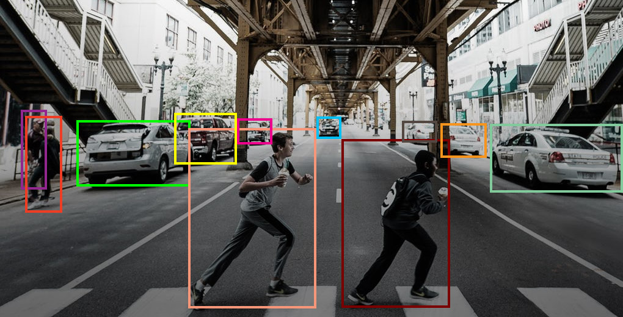
Tools of Image Labeling
LabelImg
https://www.analyticsvidhya.com/blog/tag/real-time-object-detection/

Slide 5
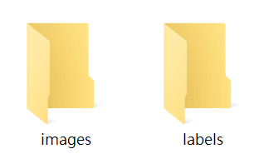
Create New Folders
Create two folders named “images” and “labels” on the desktop.
Put images in images folder.
test_label1.jpg
test_label2.jpg
Select labels to save labels folder later.
Images
Original
Images
Labels

Slide 6
LabelImg (macOS)
Install labelImg in terminal.
pip install --upgrade --user pyqtwebengine==5.12
pip install --upgrade --user pyqt5==5.12
pip install labelImg
labelImg

Slide 7
LabelImg (Windows)
Install labelImg in anaconda.
pip install PyQt5
pip install pyqt5-tools
pip install lxml
pip install labelimg
labelImg

Slide 8
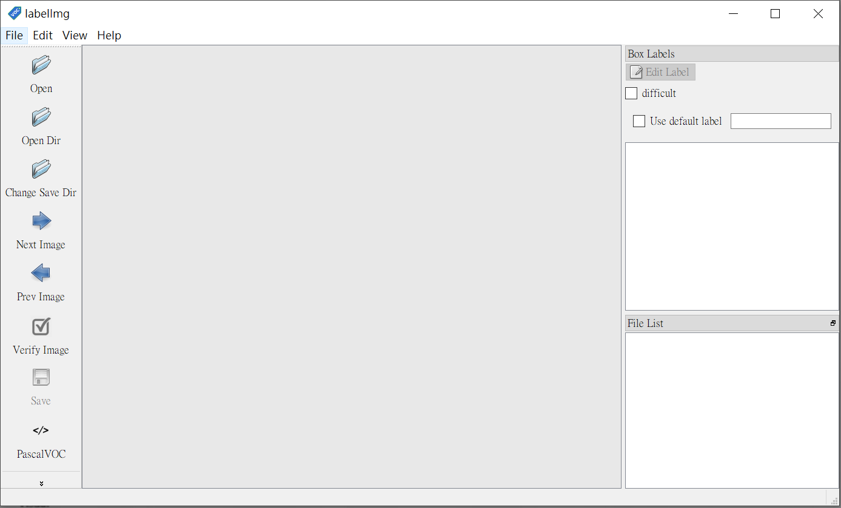
LabelImg
Choose the images.
Choose the folder which we want to save the label file in.
Choose labeling format.
(PascalVOC or YOLO)

Slide 9
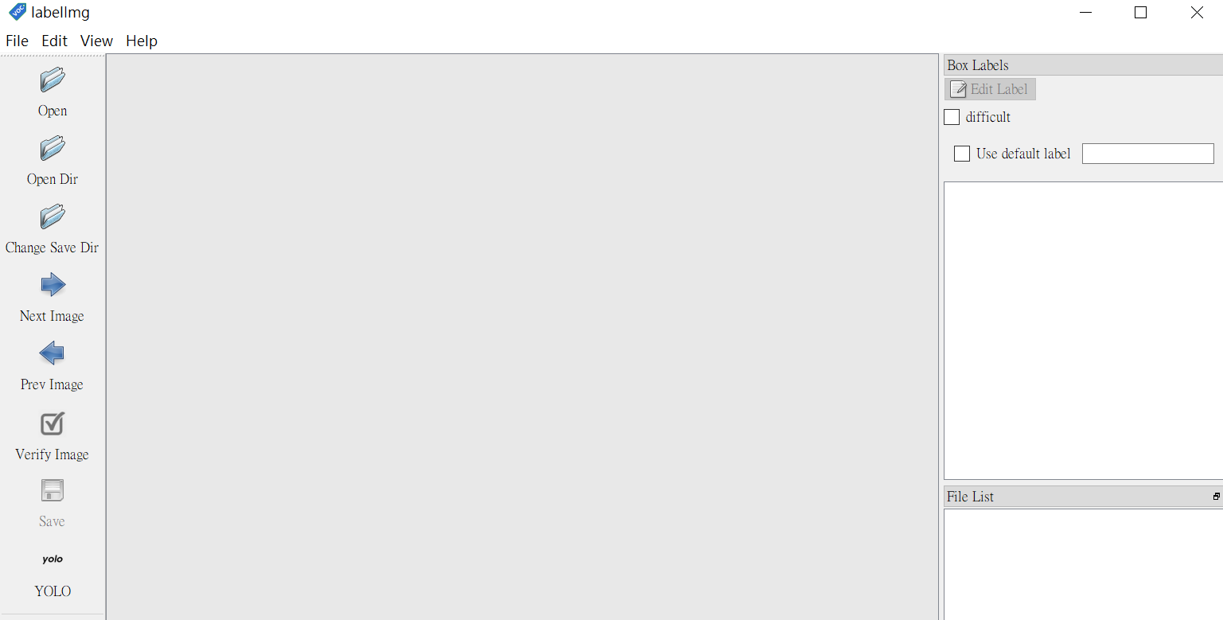
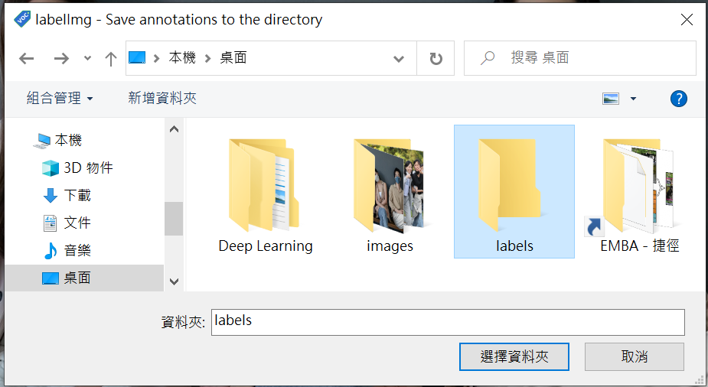
Setting
Choose the YOLO format.

Slide 10
Classes
We have three classes, good, bad, and none.
Good means someone wears mask perfectly.
Bad means someone does not wear mask.
None means someone wears mask unproperly.

Slide 11
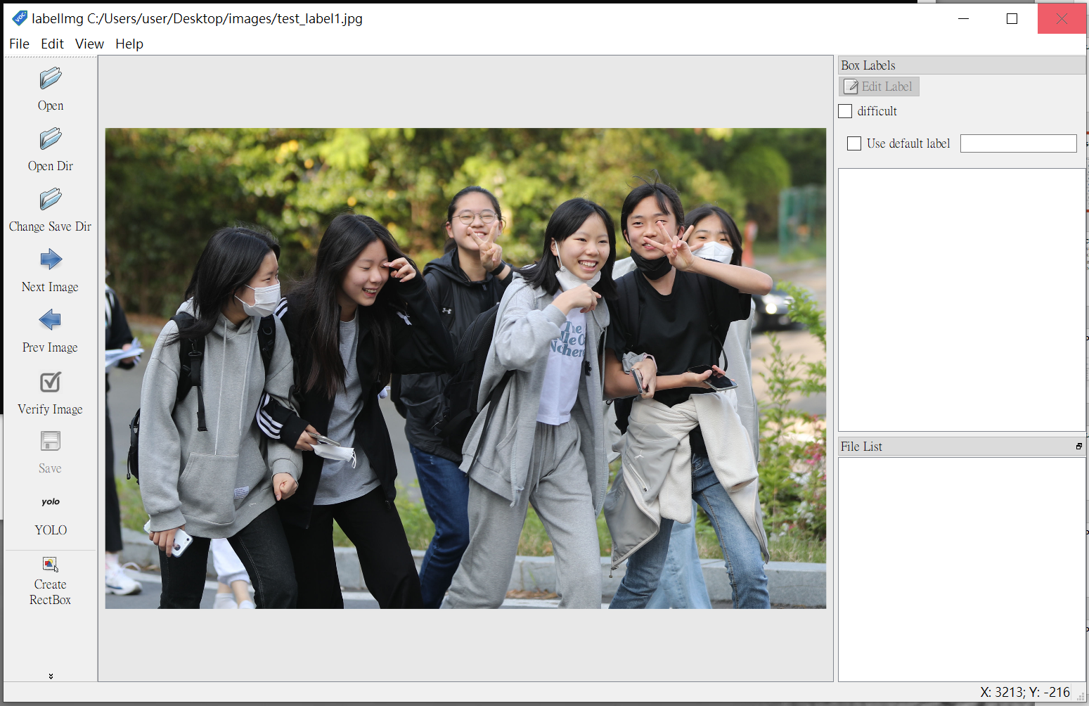
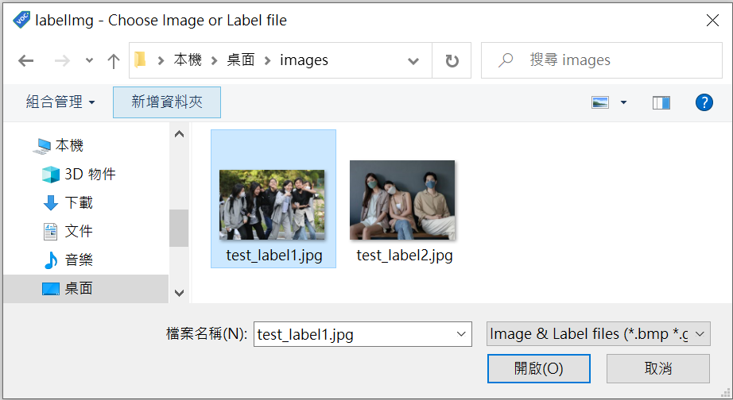
Open Image in LabelImg
https://www.ettoday.net/news/20220502/2242088.htm

Slide 12
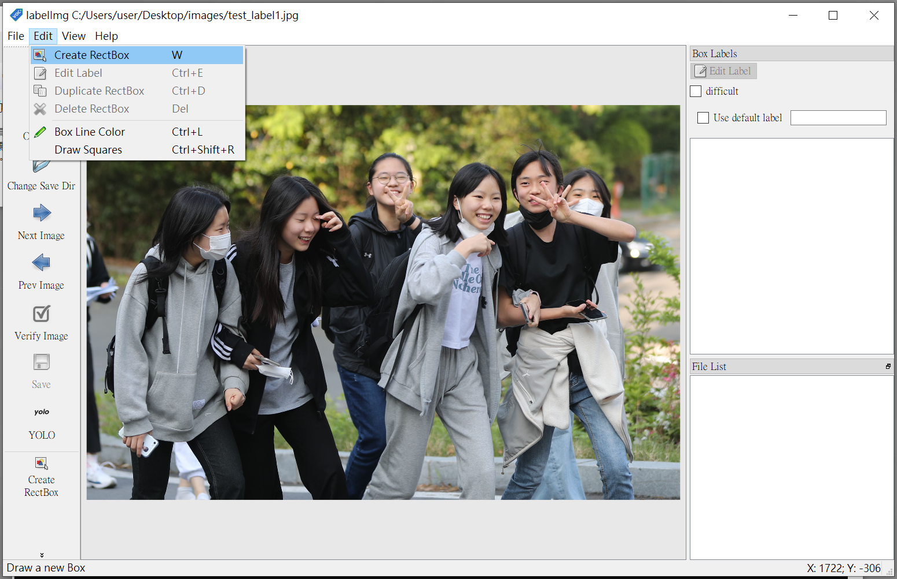
Labeling
https://www.ettoday.net/news/20220502/2242088.htm

Slide 13
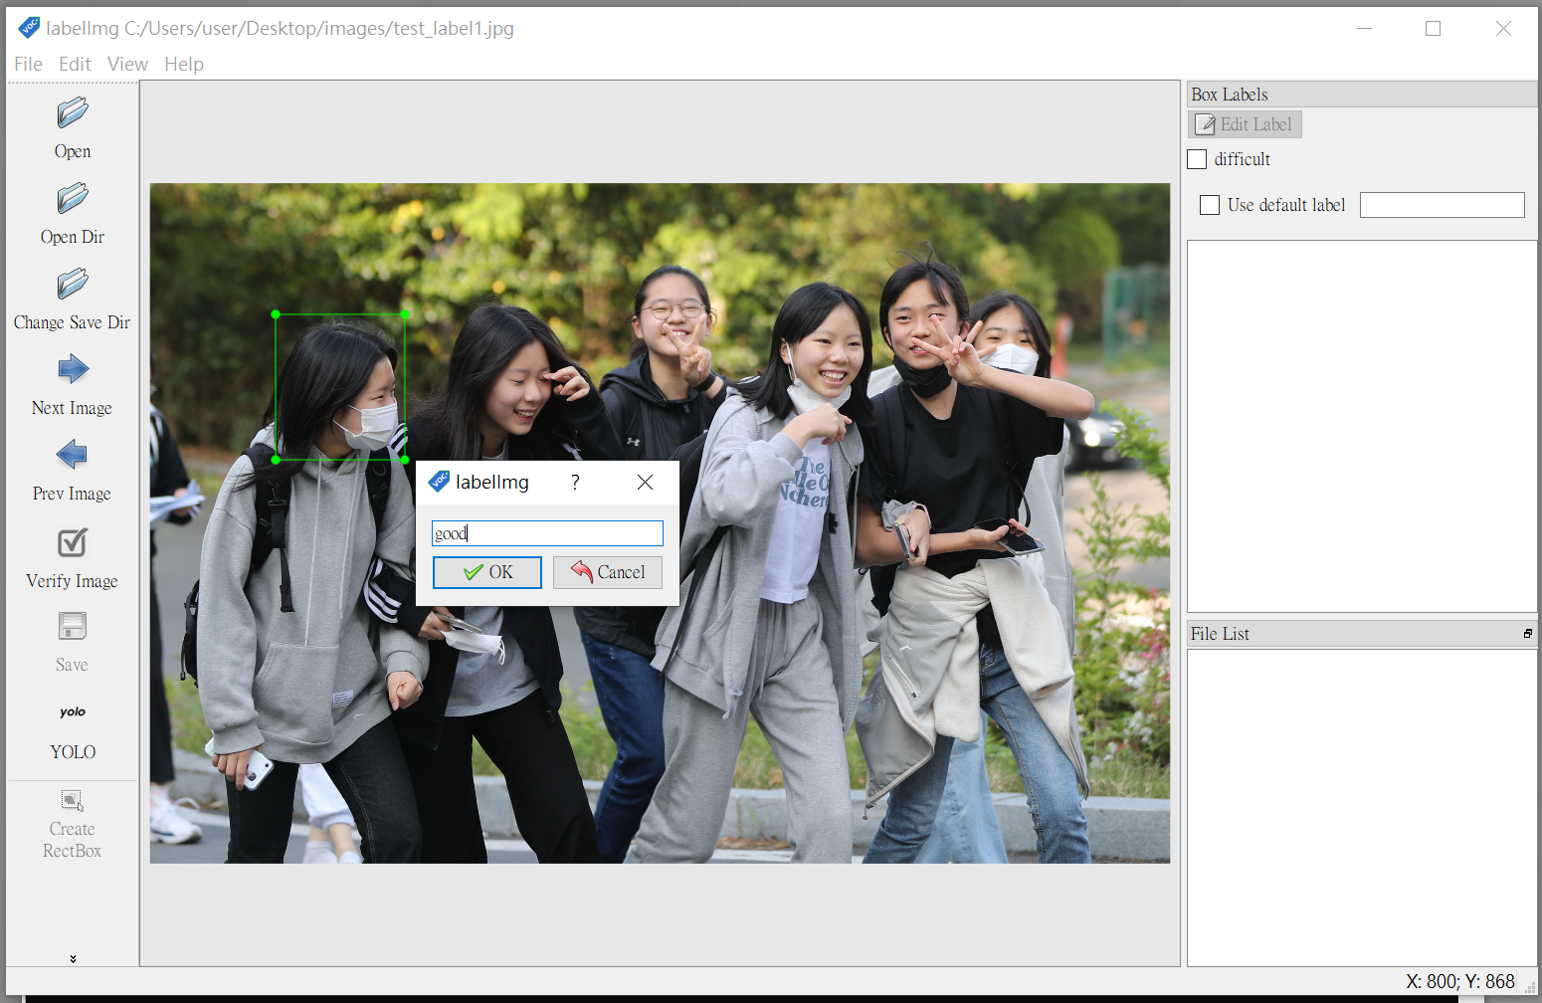
Labeling (Cont’d)
https://www.ettoday.net/news/20220502/2242088.htm

Slide 14
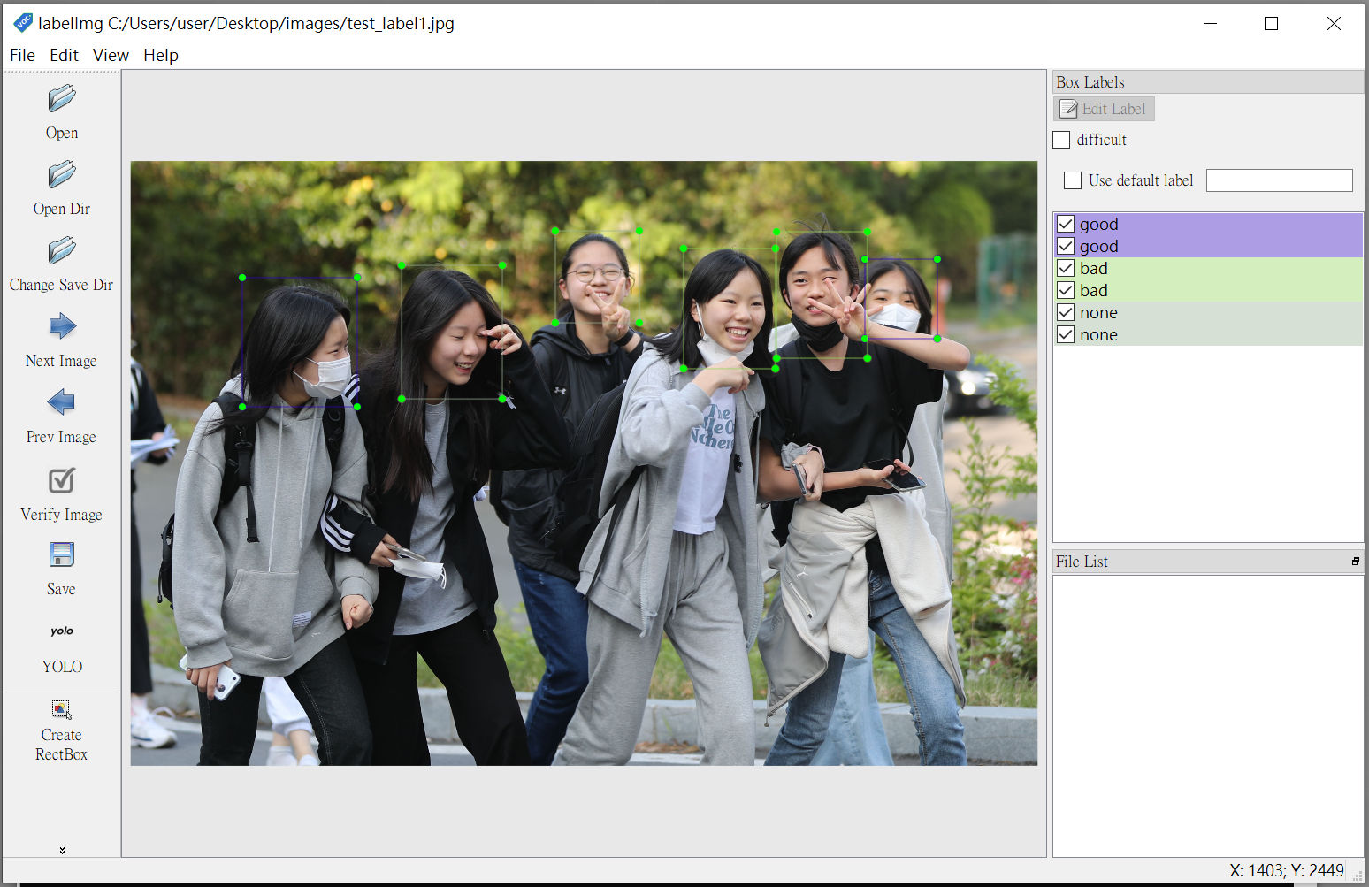
Labeling (Cont’d)
https://www.ettoday.net/news/20220502/2242088.htm

Slide 15
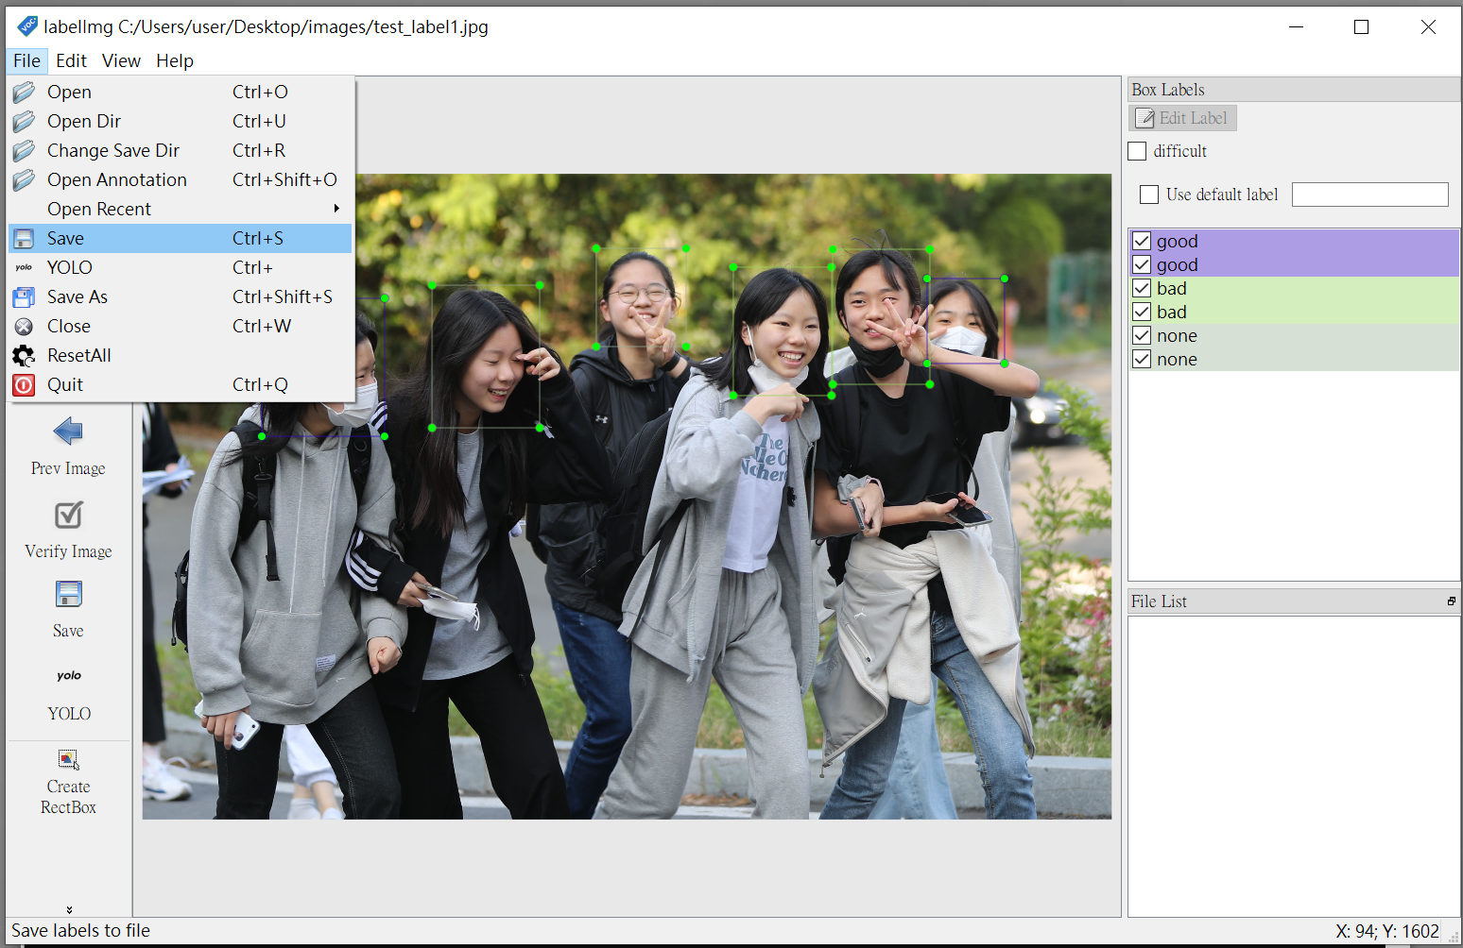
Save
https://www.ettoday.net/news/20220502/2242088.htm

Slide 16
Setting
Choose the PascalVOC format.

Slide 17
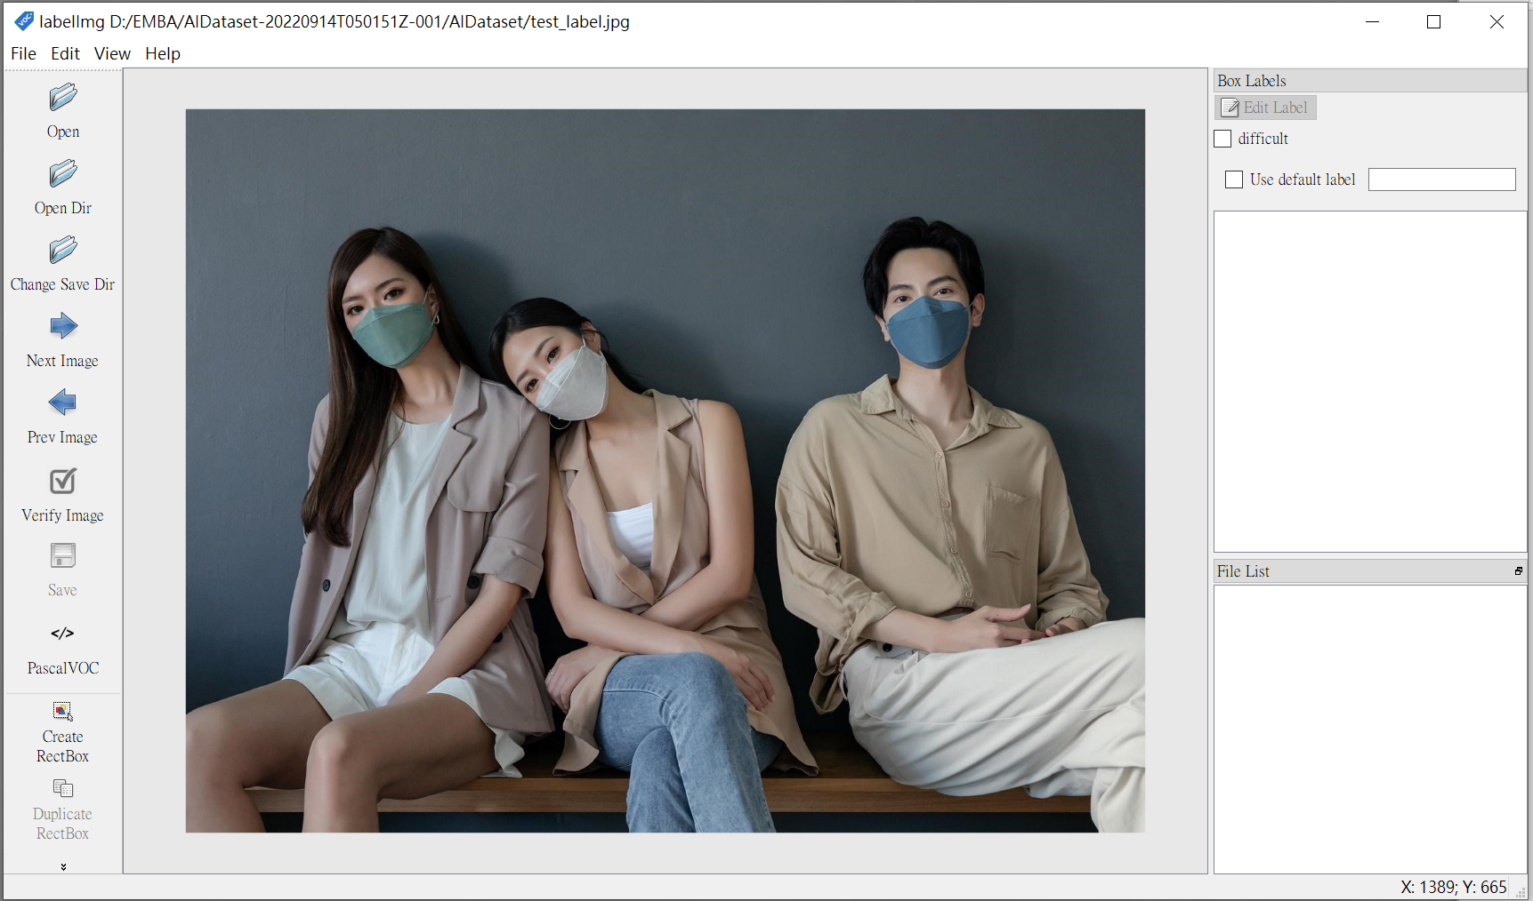
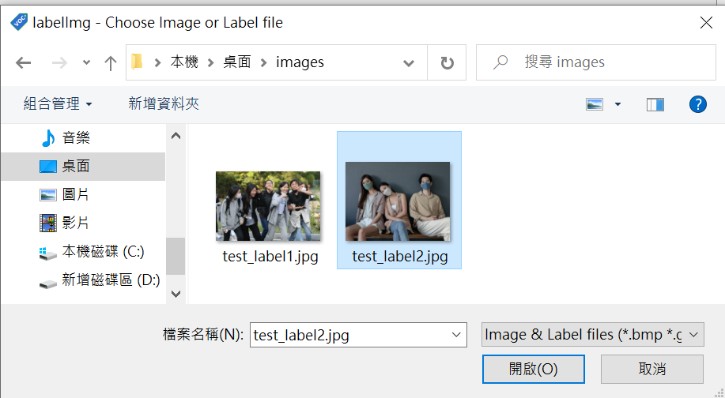
Open Image in LabelImg
https://popular.tom.com/202111/1084802260.html

Slide 18
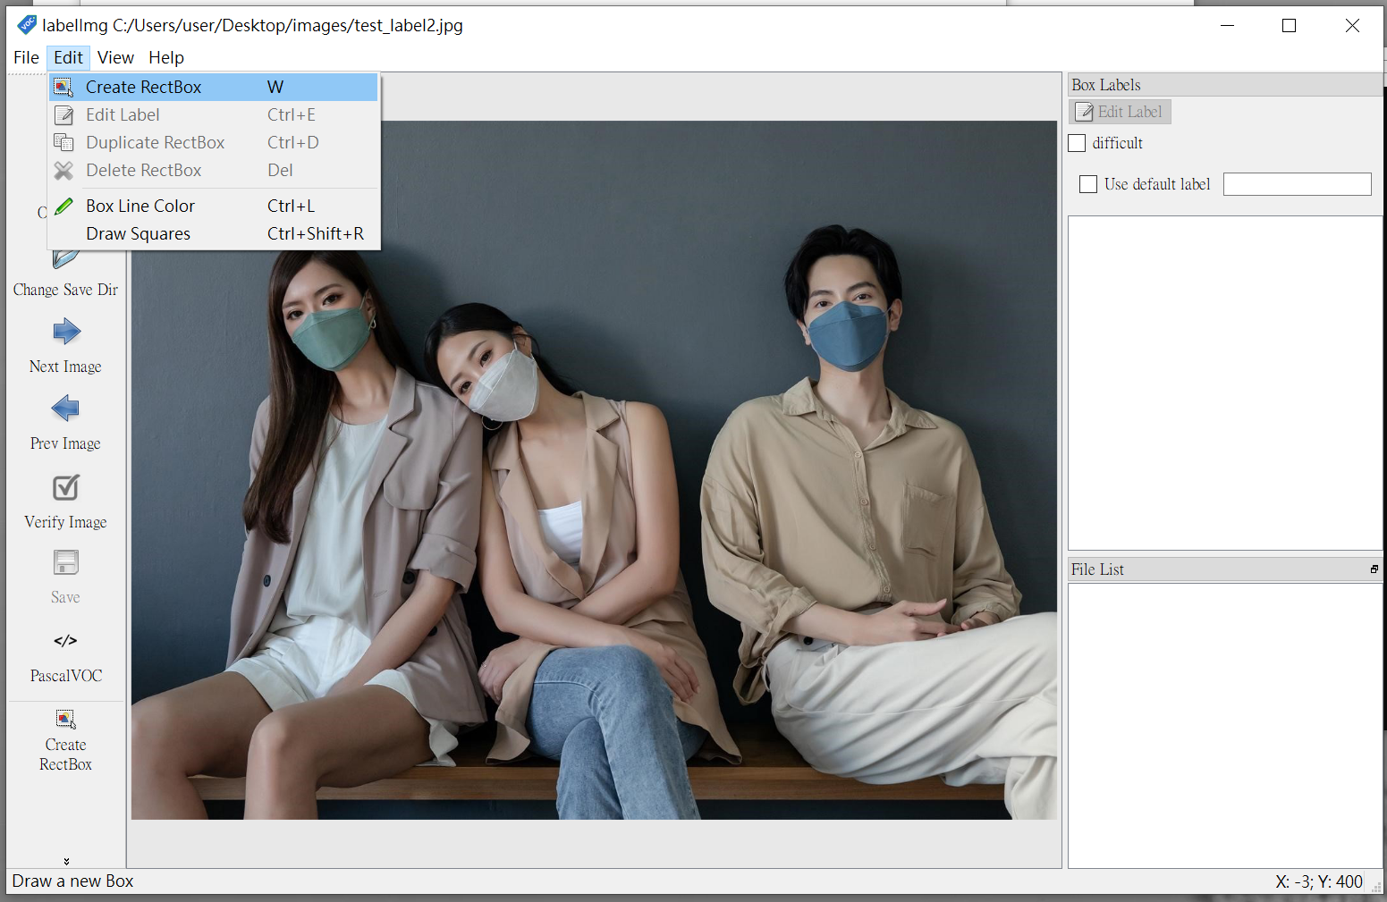
Labeling
https://popular.tom.com/202111/1084802260.html

Slide 19
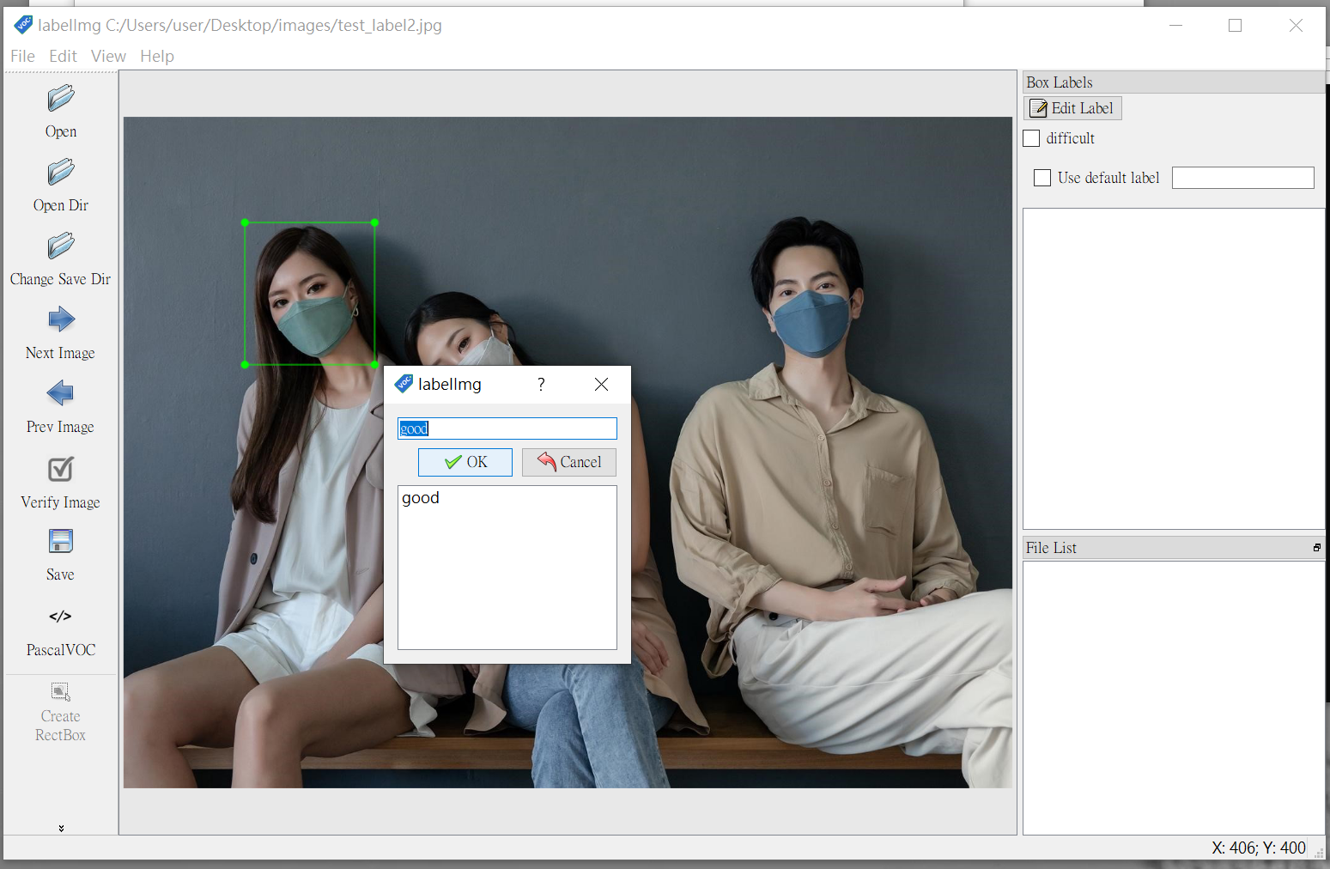
Labeling (Cont’d)
https://popular.tom.com/202111/1084802260.html

Slide 20
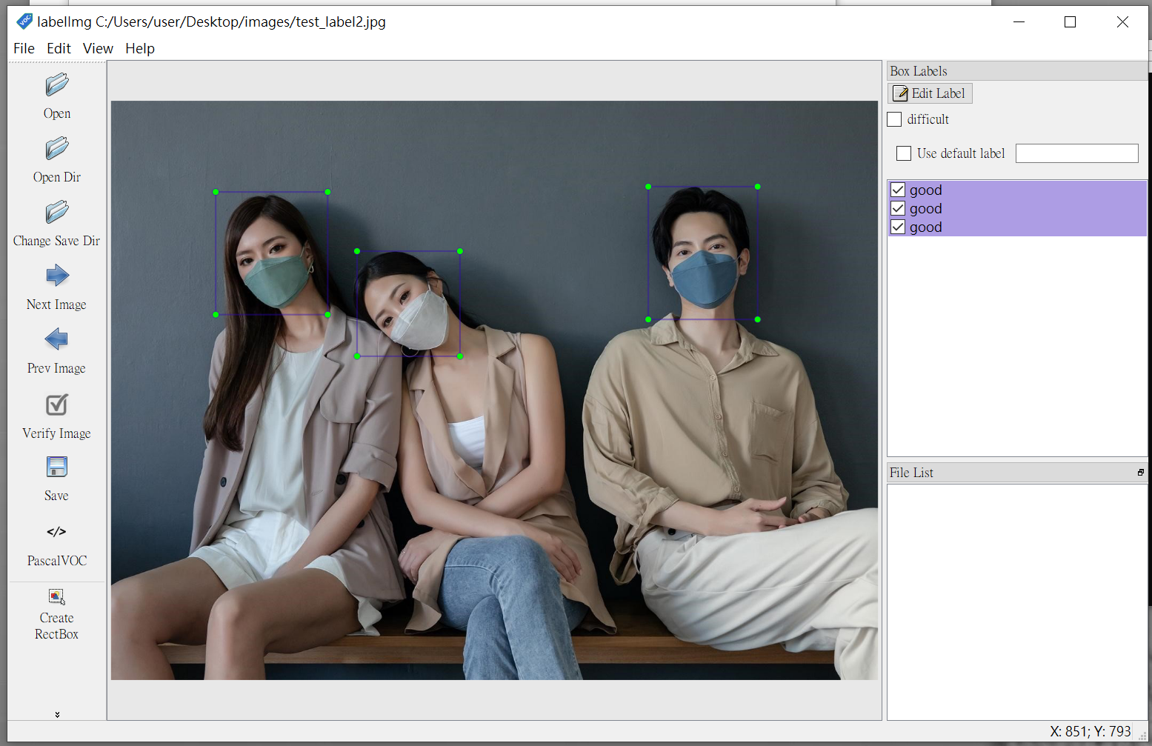
Labeling (Cont’d)
https://popular.tom.com/202111/1084802260.html

Slide 21
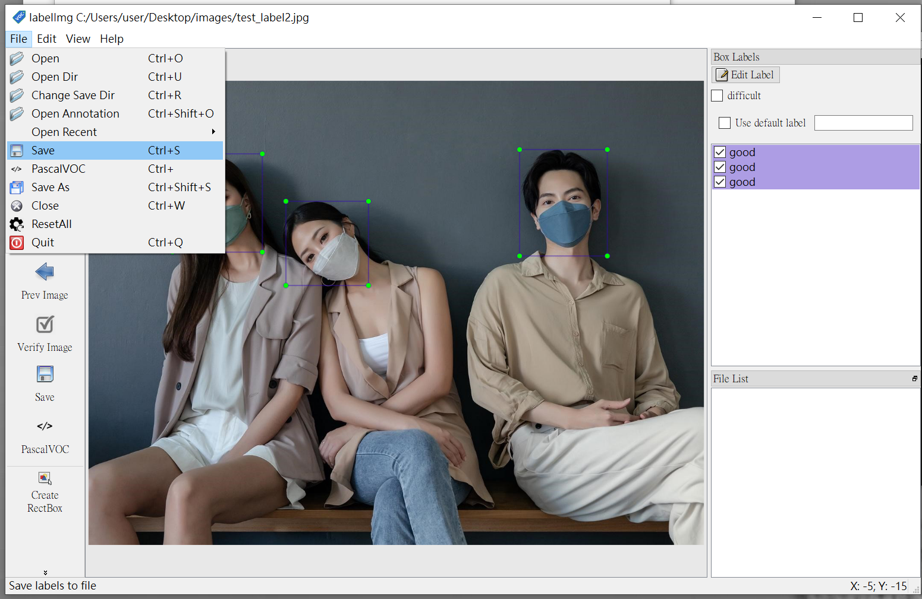
Save
https://popular.tom.com/202111/1084802260.html

Slide 22
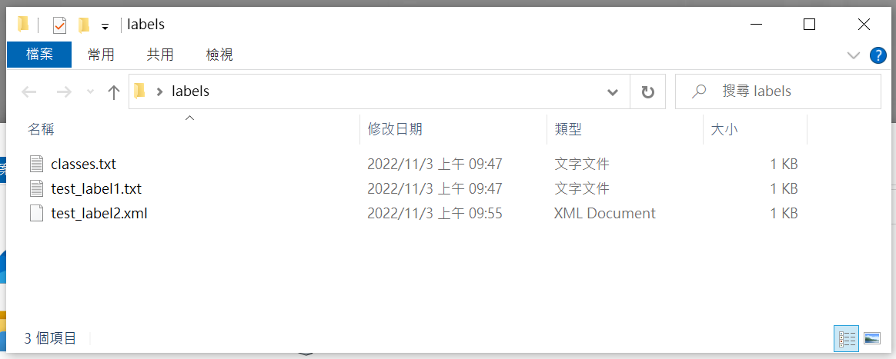
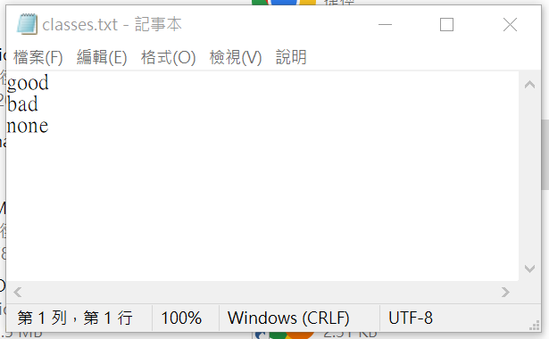
Check Label Files

Slide 23
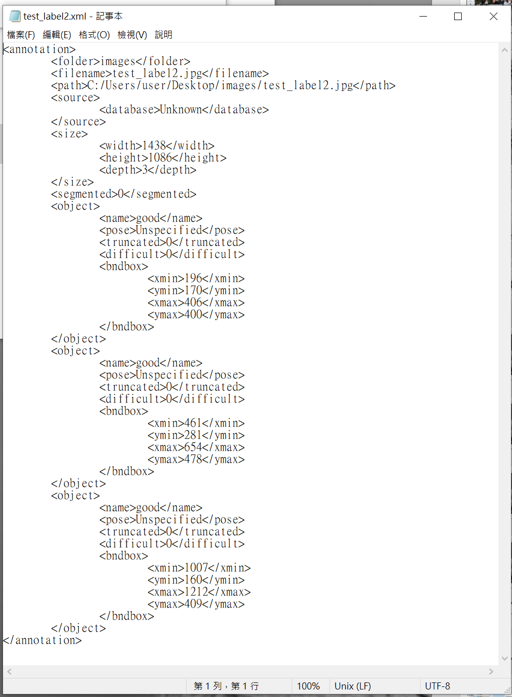
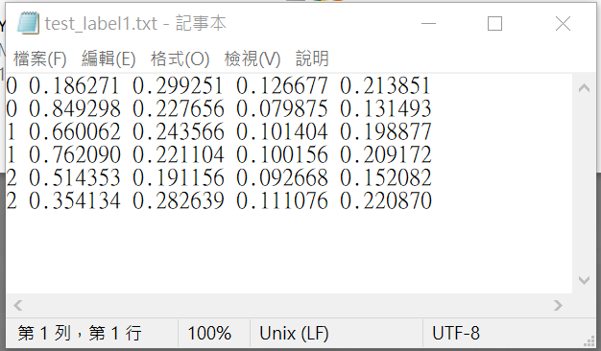
Label Files
YOLO format in .txt file
PascalVOC format in .xml file

Slide 24
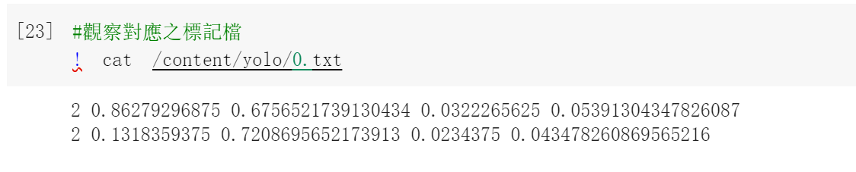
YOLO Format
Category number
The ratio of object center y to the whole image y
The ratio of object height h to the whole image h
The ratio of object center x to the whole image x
The ratio of object width w to the whole image w

Slide 25
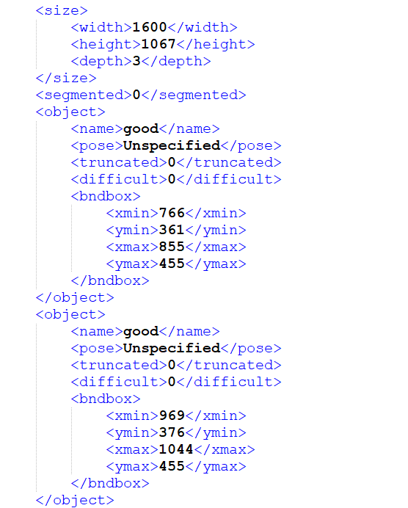
PascalVOC Format
Basic information of images
Depth means the channel of images.
For example:
If the image is RGB and the channel will be 3.
If the image is grayscale and the channel will be 2.

Slide 26
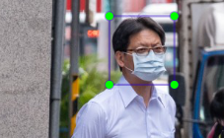
PascalVOC Format (Cont’d)
Information of label
Pose means the skewness or orientation of the image.
(xmin, ymin)
(xmax, ymax)

Slide 27
Bonus
Label two images.
Using PascalVOC format.
Using YOLO format.

Slide 28
Key Terms of Convolutional Neural Networks

Slide 29
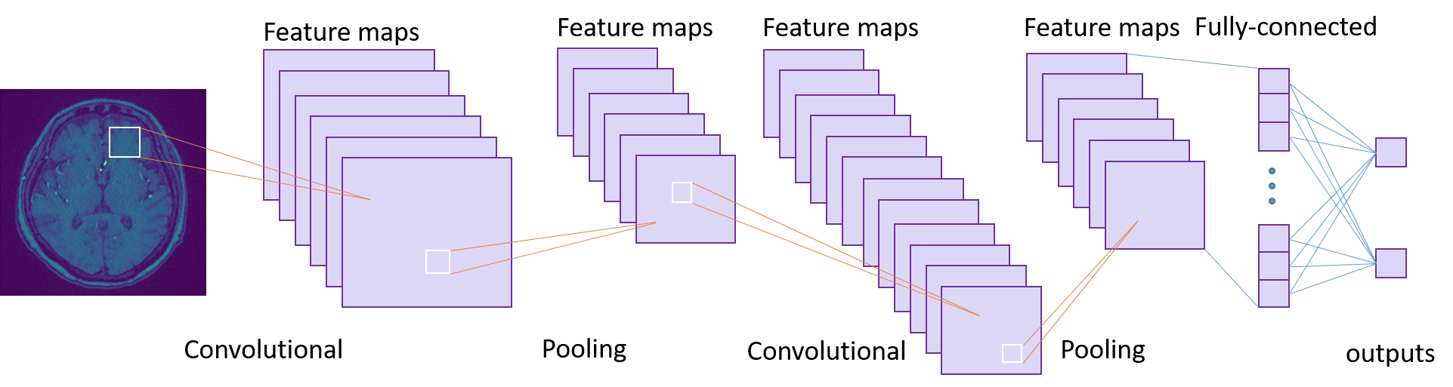
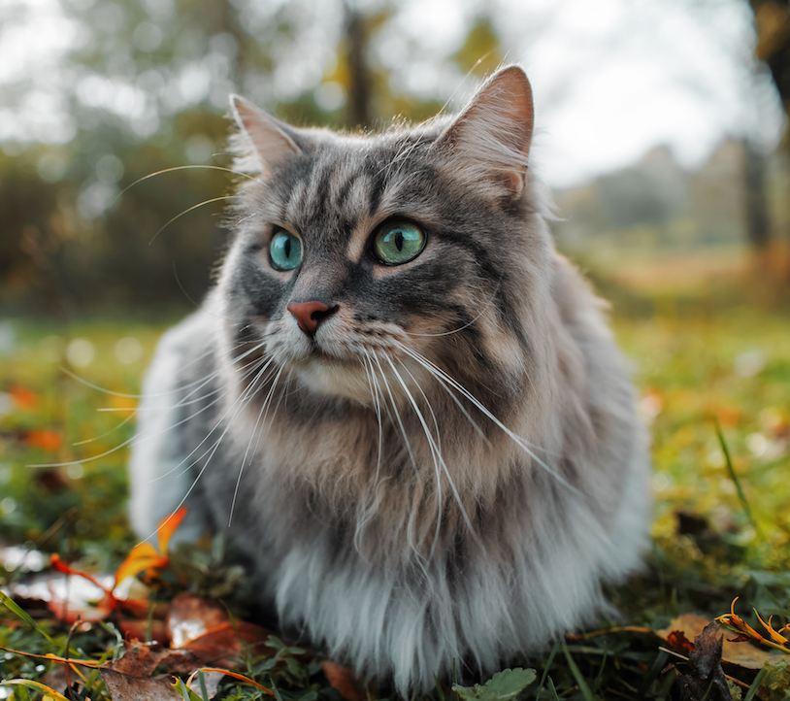
Convolutional Neural Networks (CNNs)
Convolution layer
Pooling layer
Fully-connected layer
Outputs
https://crossing.cw.com.tw/article/16099

Slide 30
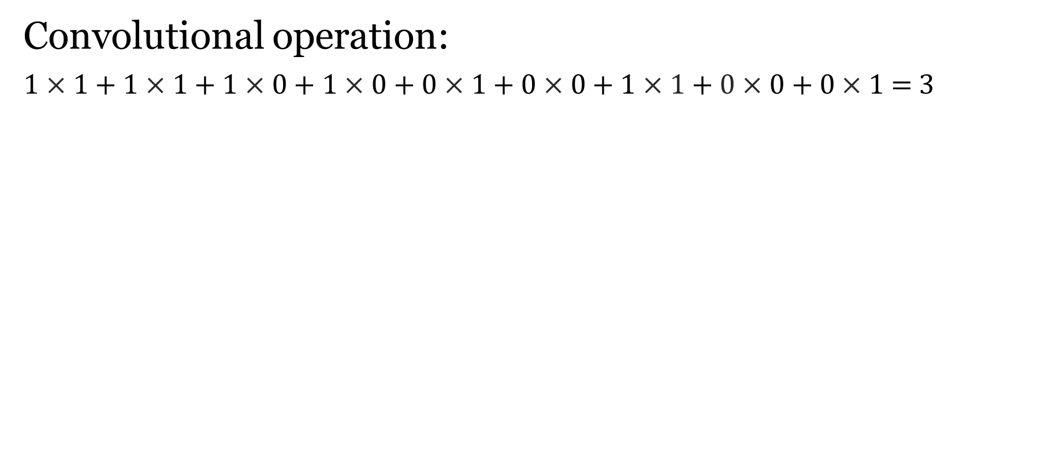
Convolutional Layer (Conv. Layer)
Convolutional operation:
1$×$ 1 + 1 $×$ 1 + 1 $×$ 0 + 1 $×$ 0 + 0$×$1 + 0 $×$ 0 + 1$×1$+$0$ $×$ 0 + 0 $×$ 1 = 3
0 | 0 | 1 | 1 | 1 | 1 | 1 | 0
0 | 1 | 1 | 0 | 1 | 0 | 0 | 0
0 | 0 | 0 | 1 | 1 | 0 | 0 | 1
0 | 1 | 1 | 0 | 1 | 0 | 0 | 1
1 | 0 | 1 | 1 | 0 | 0 | 0 | 1
1 | 1 | 0 | 1 | 0 | 0 | 0 | 0
0 | 1 | 0 | 1 | 0 | 1 | 1 | 0
0 | 0 | 1 | 1 | 0 | 1 | 1 | 0
1 | 3 | 3 | 4 | 3 | 3
2 | 3 | 4 | 2 | 2 | 1
3 | 2 | 2 | 4 | 1 | 1
2 | 5 | 2 | 3 | 1 | 0
2 | 3 | 3 | 3 | 1 | 1
4 | 2 | 3 | 3 | 2 | 2
1 | 1 | 0
0 | 1 | 0
1 | 0 | 1
=
Kernel
Feature Map
Input Image

Slide 31
Pooling Layer
Max Pooling: Take the maximum value in the box.
Average Pooling: Take the average value in the box.
8 | 9
5 | 8
Max Pooling
4 | 8 | 9 | 8
5 | 7 | 7 | 6
1 | 2 | 7 | 8
3 | 5 | 5 | 5
Feature Map
Pooling
6 | 7.5
2.75 | 6.25
Average Pooling

Slide 32
Fully-connected Layer (Conn. Layer)
1
1
0
4
2
1
0
2
1
1 | 4 | 0
4 | 2 | 1
0 | 2 | 1
Flattening
Pooled Feature Map
Neural Network

Slide 33
Object Detection

Slide 34
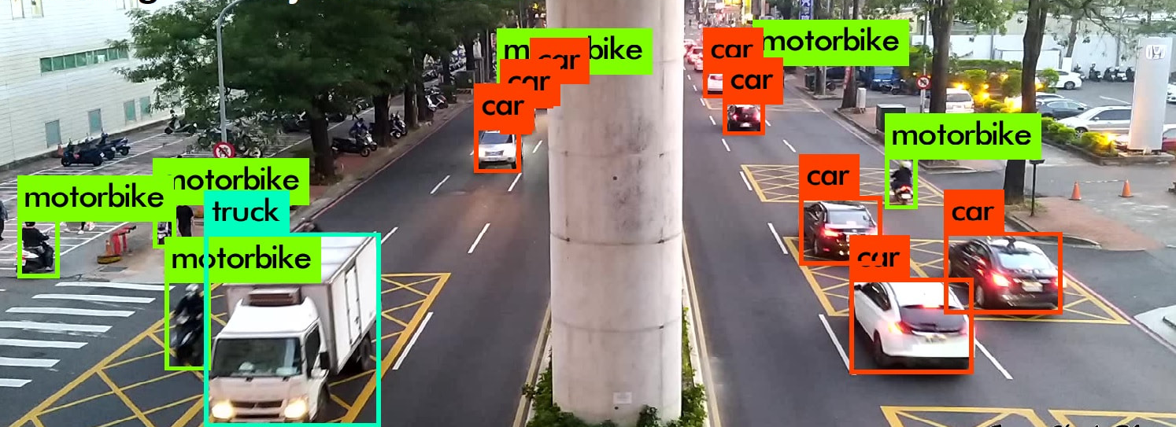
What is Object Detection?
To identify the object in image or video.
https://jason-chen-1992.weebly.com/home/-labelimg

Slide 35
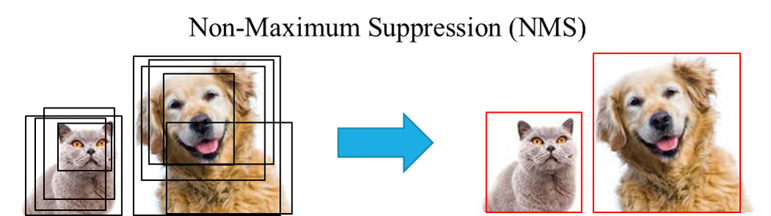
Bounding Box
Each bounding box contains 5 elements:
(x, y) = coordinates representing center of box.
(w, h) = width and height of box.
Confidence score = represents presence/absence of any object.
Figure 1
Figure 2
https://chih-sheng-huang821.medium.com/%E6%A9%9F%E5%99%A8-%E6%B7%B1%E5%BA%A6%E5%AD%B8%E7%BF%92-%E7%89%A9%E4%BB%B6%E5%81%B5%E6%B8%AC-non-maximum-suppression-nms-aa70c45adffa

Slide 36
You Only Look Once (YOLO)

Slide 37

What is YOLO?
YOLO is an algorithm that uses neural networks to provide real-time object detection.
https://pjreddie.com/darknet/yolo/

Slide 38
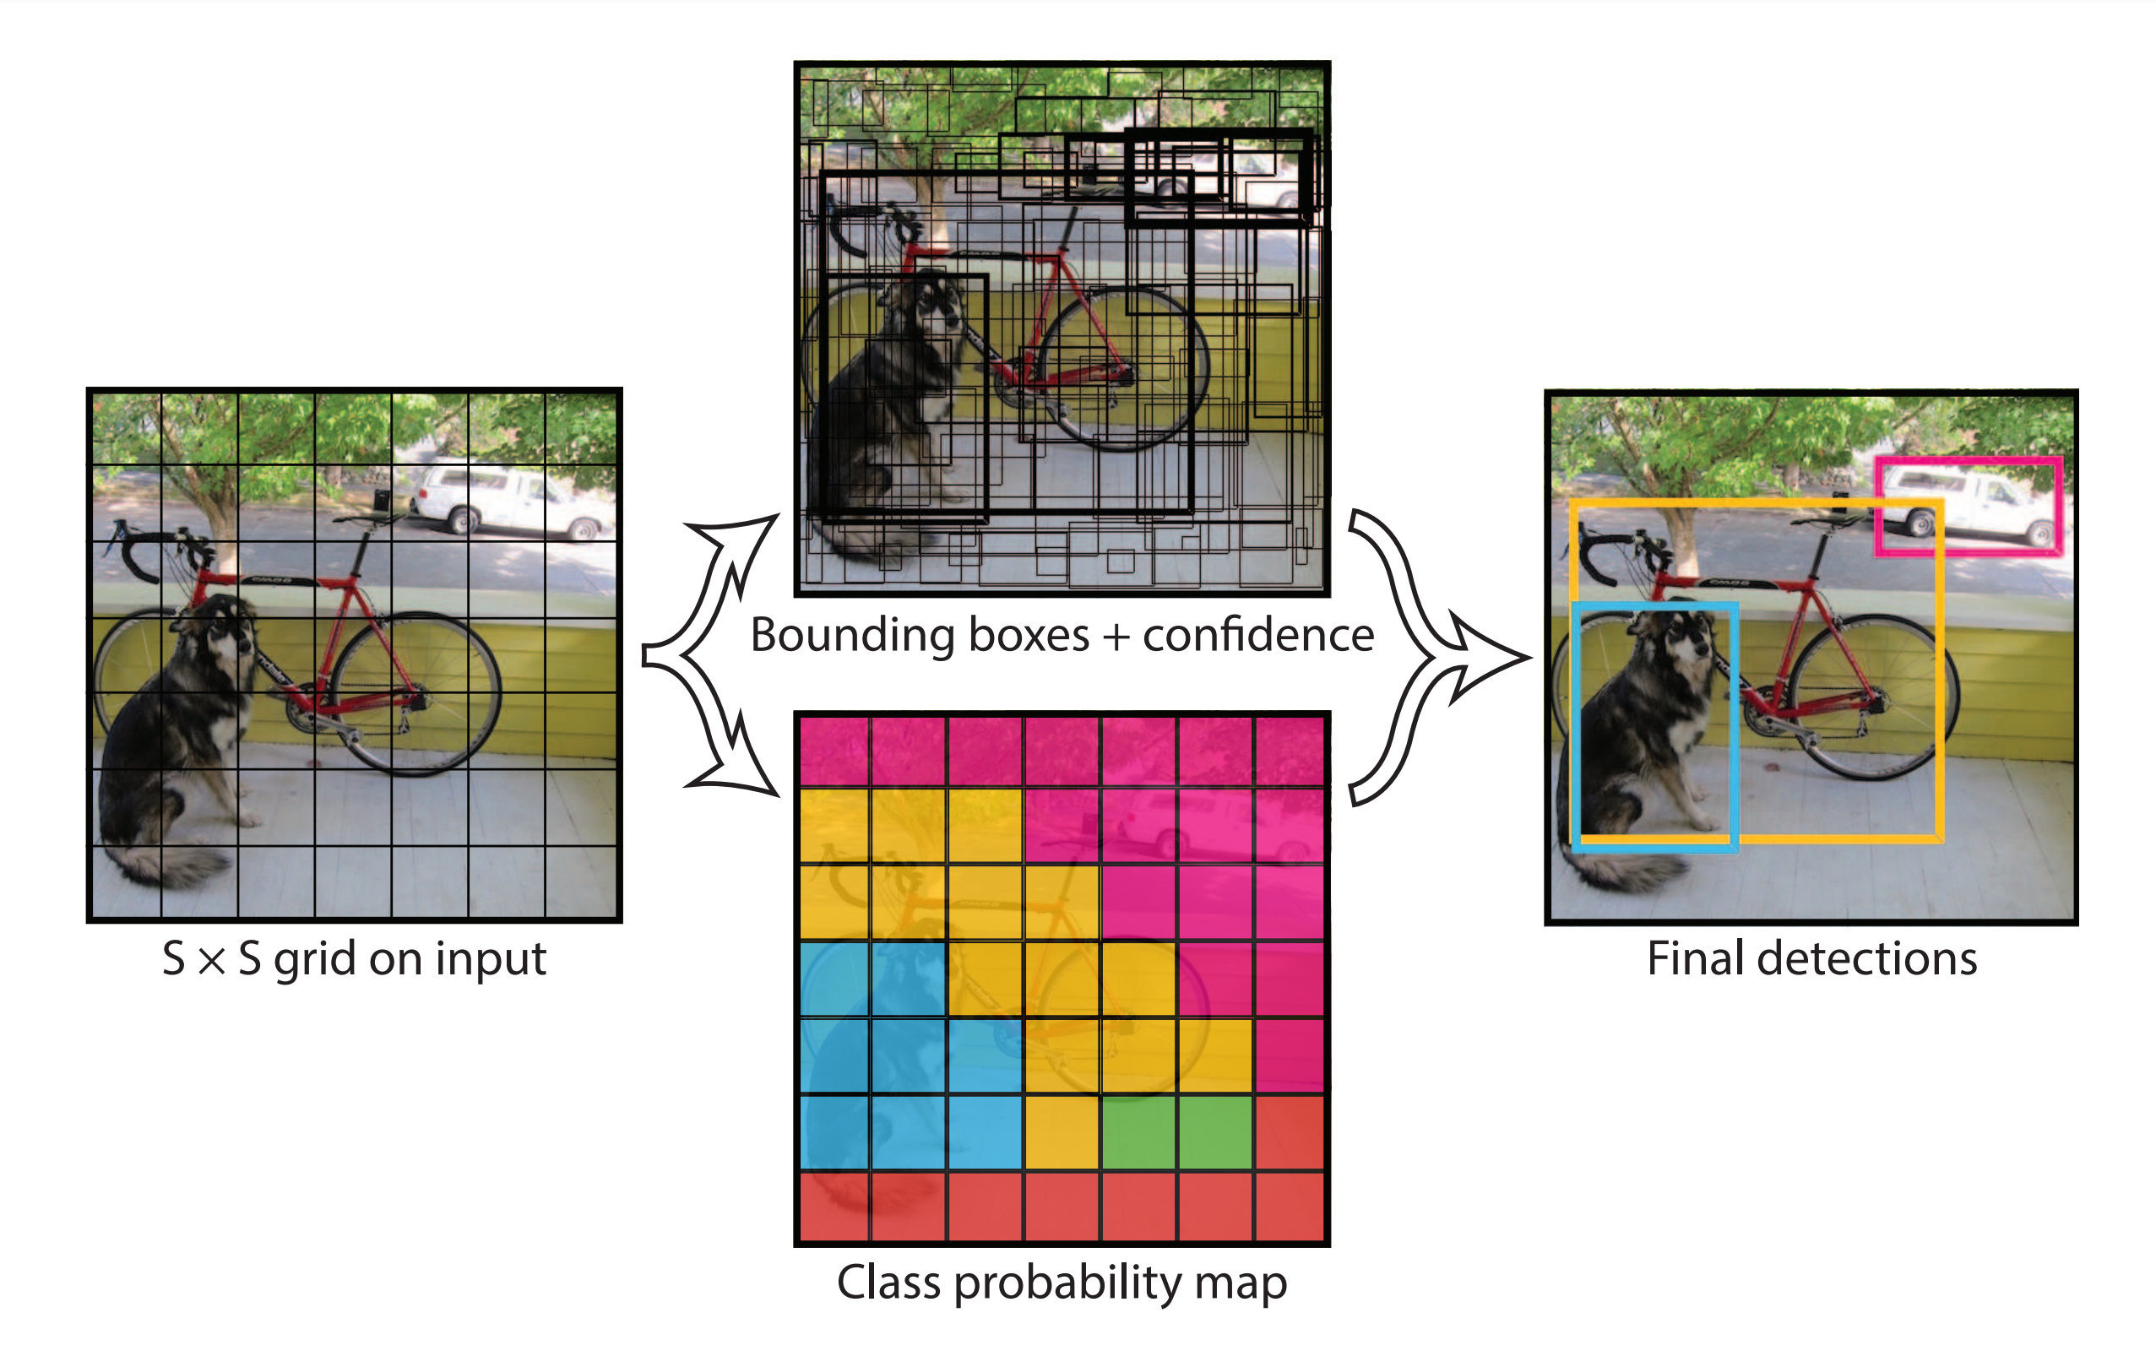
YOLO
https://www.cv-foundation.org/openaccess/content_cvpr_2016/papers/Redmon_You_Only_Look_CVPR_2016_paper.pdf

Slide 39
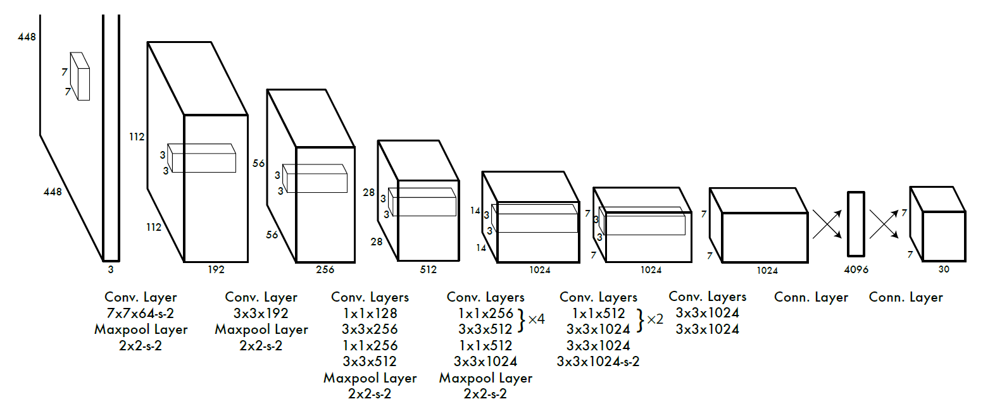
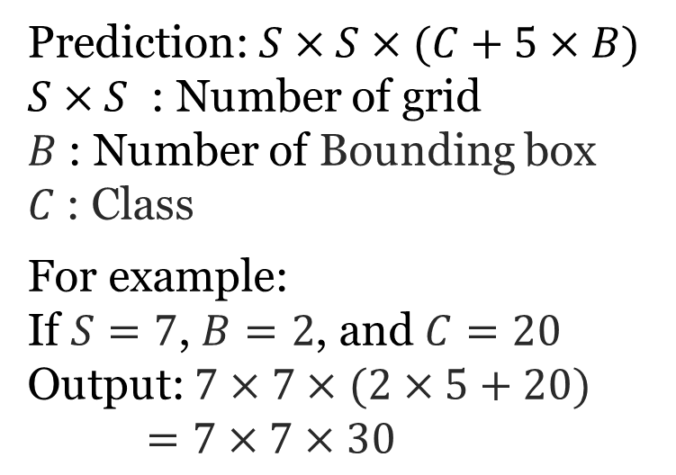
Evolution of YOLOv1
Prediction: $S×S×(C+5×B)$
$S×S$ : Number of grid
$B$: Number of Bounding box
$C$: Class
For example:
If $S=7$, $B=2$, and $C=20$
Output: $7×7×$ $(2×5+20)$
$=7×7×30$
Input Image for 448 × 448
https://arxiv.org/pdf/1604.07043.pdf

Slide 40
Evolution of YOLOv1 (Cont’d)
YOLOv1 use GoogLeNet as for network.
GoogLeNet is a CNN.
GoogLeNet
https://arxiv.org/pdf/1604.07043.pdf

Slide 41
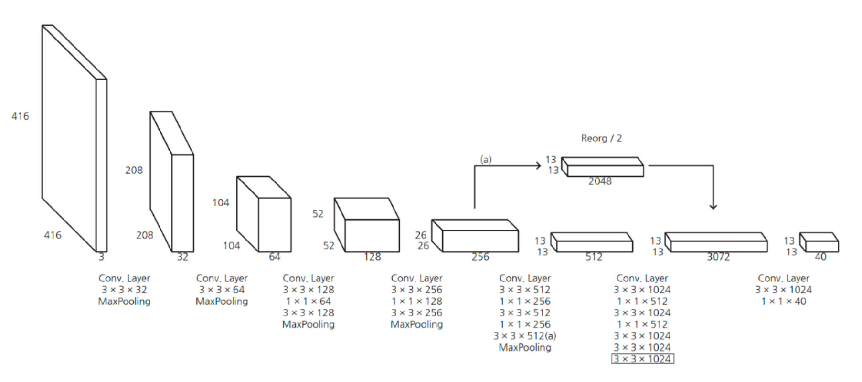
Evolution of YOLOv2
Change the size of input image from 448 × 448 to 416 × 416.
https://www.researchgate.net/figure/The-architecture-of-YOLOv2_fig4_336177198

Slide 42
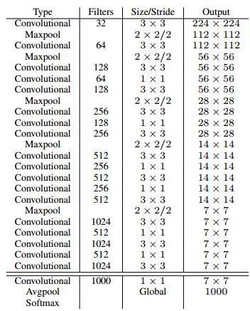
Evolution of YOLOv2 (Cont’d)
Change the network from GoogLeNet to Darknet-19.
Darknet-19
Darknet-19
https://www.researchgate.net/figure/The-architecture-of-YOLOv2_fig4_336177198

Slide 43
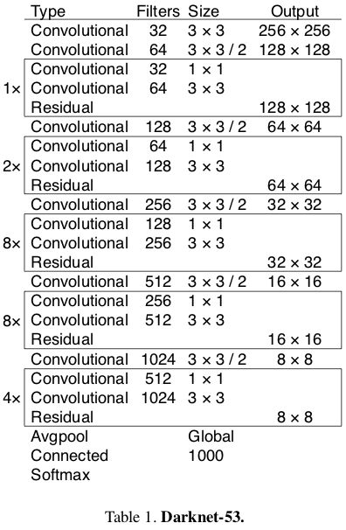
Evolution of YOLOv3
Change the network from Darknet-19 to Darknet-53.
Darknet-19
Darknet-53
https://arxiv.org/pdf/1804.02767.pdf
https://ithelp.ithome.com.tw/articles/10252820

Slide 44
YOLOv4

Slide 45
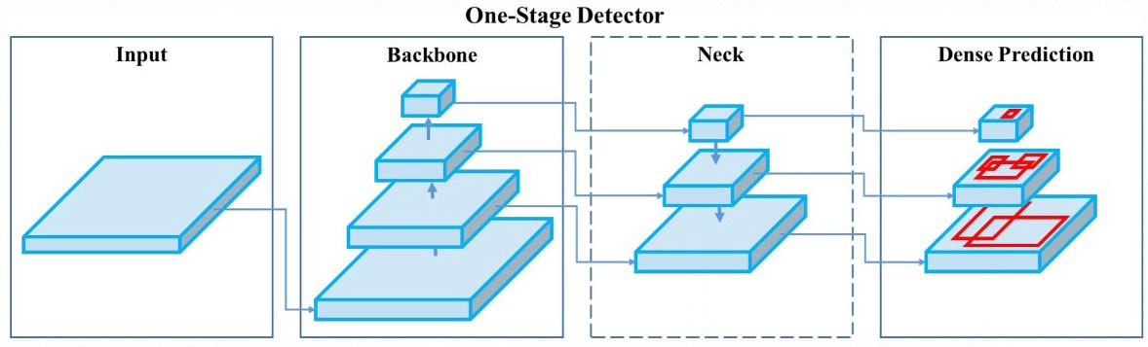
Architecture of YOLOv4
Input: Input Image
Backbone: Cross Stage Partial Darknet53 (CSPDarknet53)
Neck: Spatial Pyramid Pooling (SPP)
+ Path Aggregation Network (PANet)
Head: YOLO Head
Input
Backbone
Neck
Head
https://jonathan-hui.medium.com/yolov4-c9901eaa8e61

Slide 46
Backbone – CSPDarknet-53
CSPDarknet-53 is the application of CSP architecture to Darknet-53.
Base layer
Base layer
Part 1
Part 2
Darknet53
Darknet53
Transition
Transition
Transition
Figure 1. Darknet-53
Figure 2. CSPDarknet-53

Slide 47
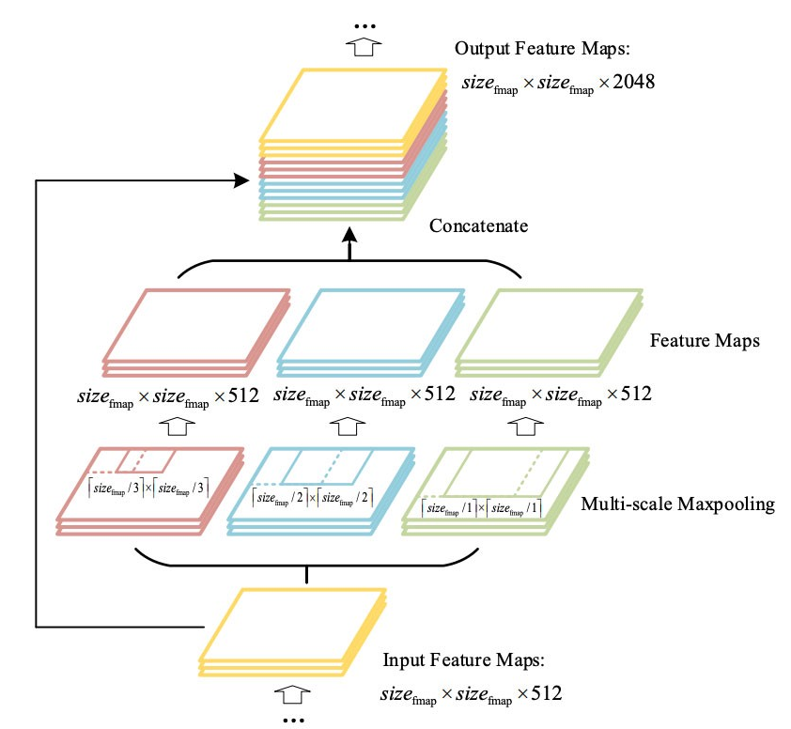
Neck – SPP + PANet
SPP:
Concatenate all feature maps in the last layer of the network, and continue to concatenate Convolutional Neural Network (CNN) modules.
https://medium.com/ching-i/yolo%E6%BC%94%E9%80%B2-3-yolov4%E8%A9%B3%E7%B4%B0%E4%BB%8B%E7%B4%B9-5ab2490754ef

Slide 48
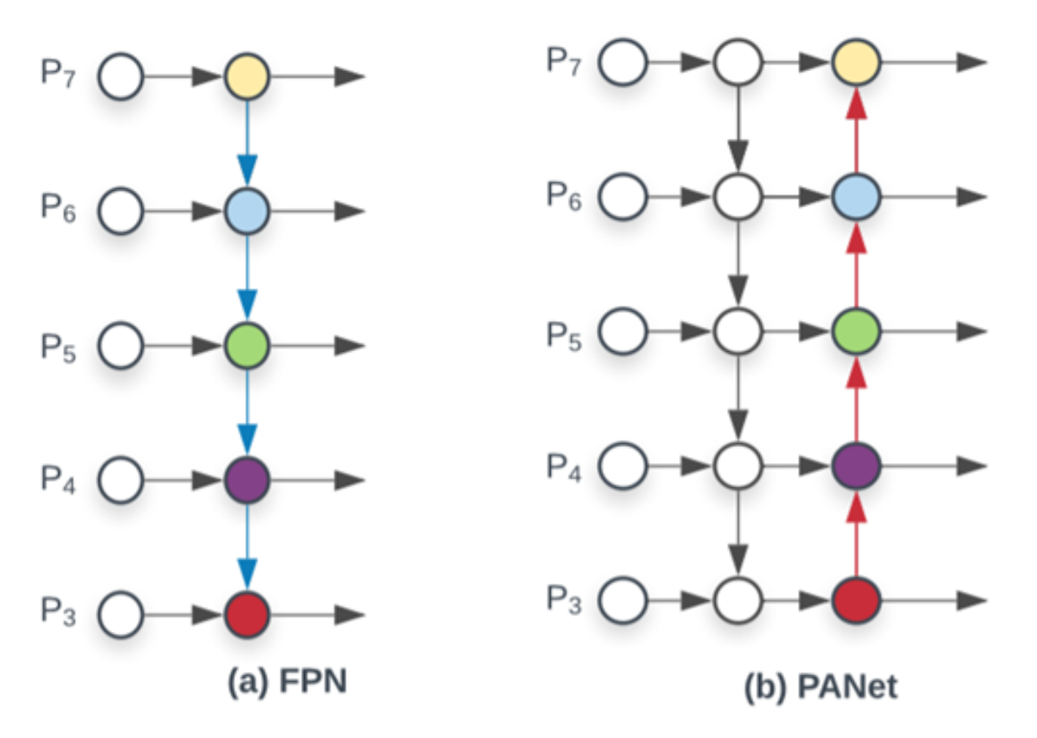
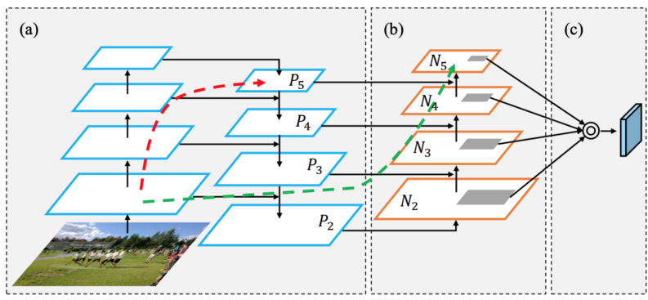
Neck – SPP + PANet (Cont’d)
Path Aggregation Network (PANet): Green one
Feature Pyramid Network (FPN): Red one
(a) FPN backbone (b) Bottom-up path augmentation (c) Adaptive feature pooling
FPN
PANet
https://www.cv-foundation.org/openaccess/content_cvpr_2016/papers/Redmon_You_Only_Look_CVPR_2016_paper.pdf
https://medium.com/@chingi071/yolo%E6%BC%94%E9%80%B2-3-yolov4%E8%A9%B3%E7%B4%B0%E4%BB%8B%E7%B4%B9-5ab2490754ef

Slide 49
Object Detection with YOLOv4

Slide 50
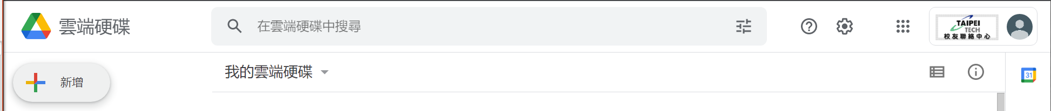
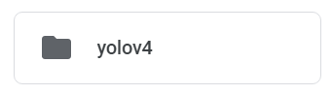
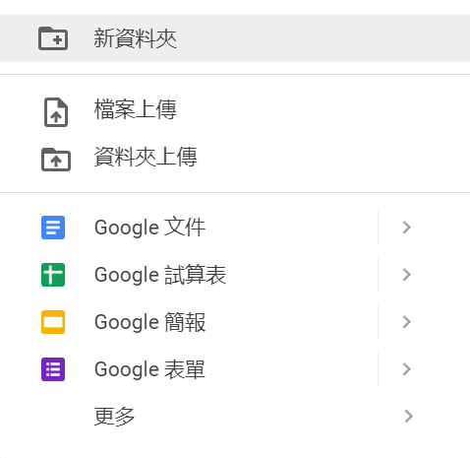
Create a Folder in Google Drive

Slide 51
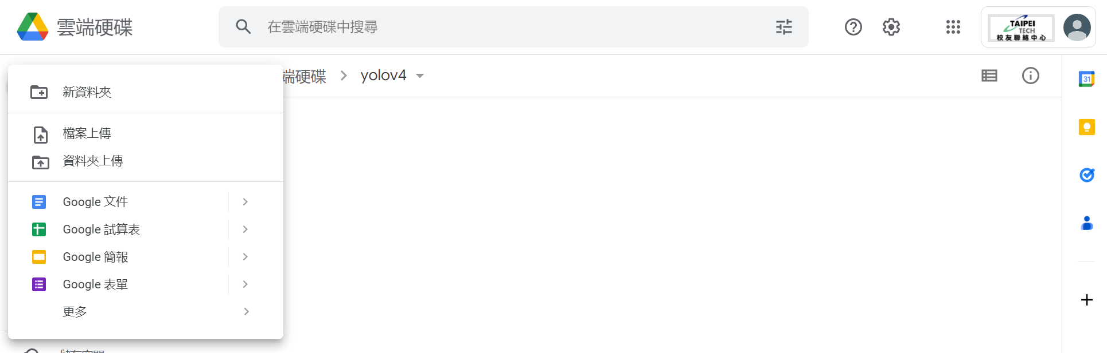
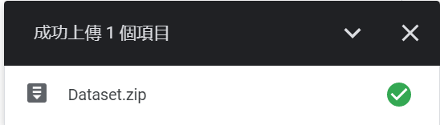
Upload Dataset.zip to Google Drive
Please upload Dataset.zip file to yolov4 folder in google drive.

Slide 52

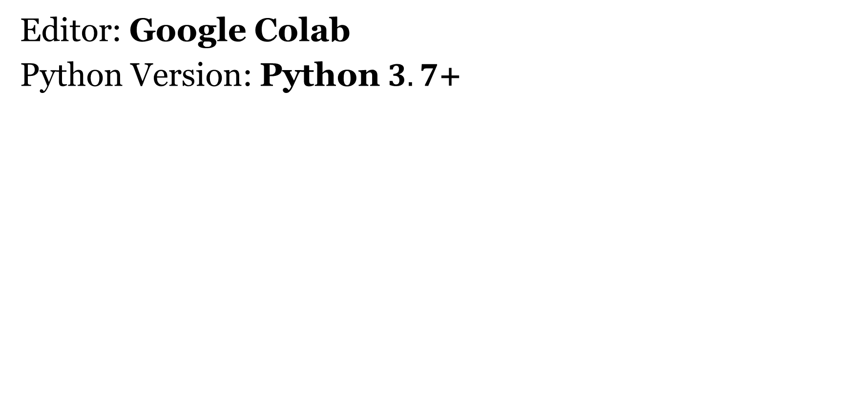
Outline
Editor: Google Colab
Python Version: Python $3.7$+
https://steam.oxxostudio.tw/category/python/info/online-editor.html

Slide 53
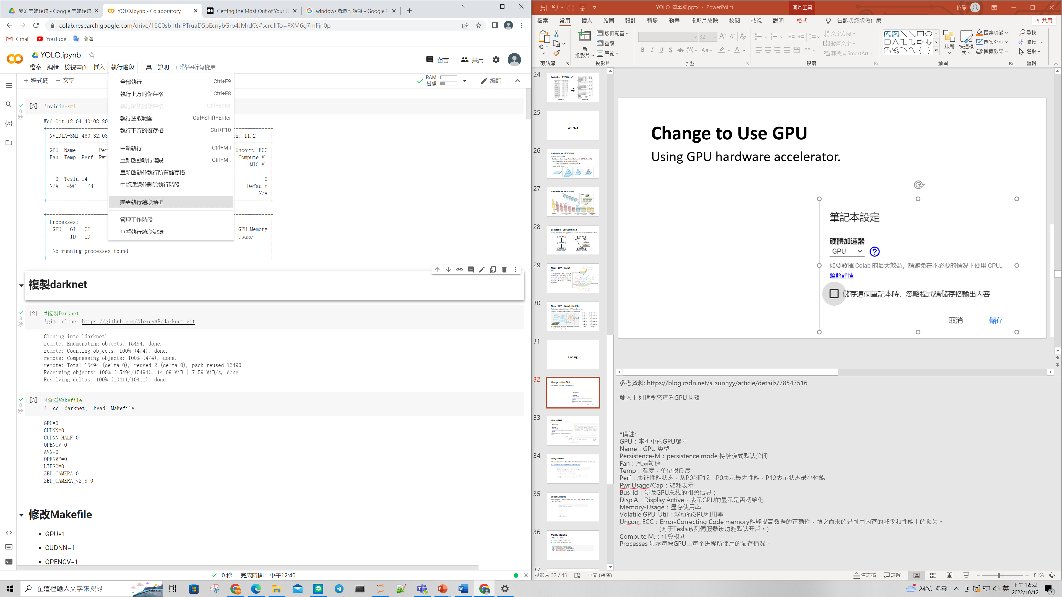
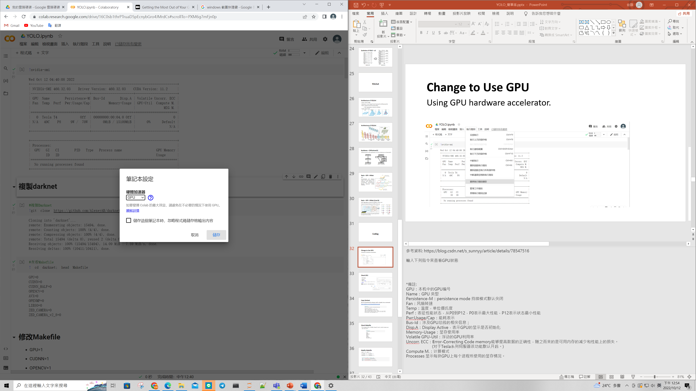
Change to Use GPU
Using GPU hardware accelerator.
Runtime –> Change runtime type –> Select GPU –> Save.

Slide 54
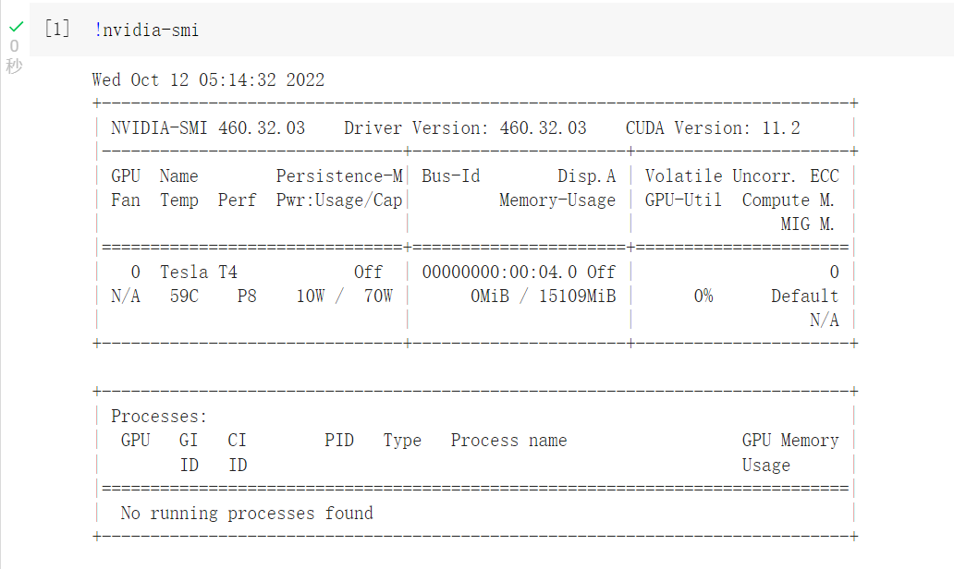
Check GPU
Check GPU in Google Colab with Linux command.

Slide 55
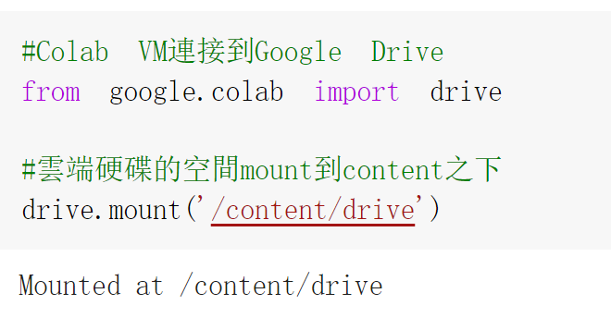
Connected to Google Drive

Slide 56
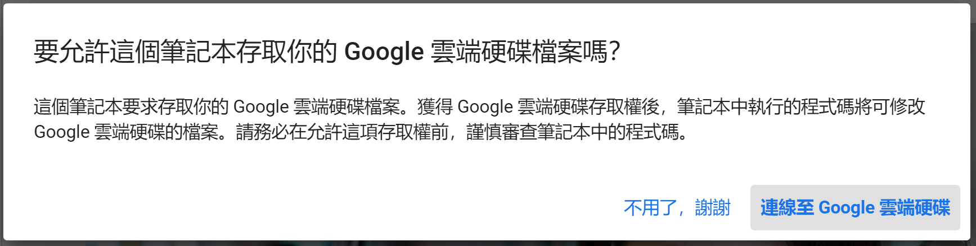
Connected to Google Drive (Cont’d)

Slide 57


Connected to Google Drive (Cont’d)

Slide 58

Move into the Folder
We are under the content folder now, we have to move into the yolov4 folder.
Make sure which folder you are from now on.

Slide 59

Unzip the Dataset
Be careful we are under yolov4 folder now.

Slide 60

Download Darknet
Be careful we are under yolov4 folder now.
Download the darknet from AlexeyAB’s Github.
https://github.com/AlexeyAB/darknet

Slide 61

Move into Darknet Folder
We are going to use the darknet. As a result, we have to move into darknet folder, which is under yolov4 folder.

Slide 62

Check the Makefile
Be careful we are under darknet folder now.

Slide 63

Modify the Makefile
Modify Makefile with Linux command.
The original text from Makefile, please type exactly the same as slide.

Slide 64

Check the Makefile
Be careful we are under darknet folder now.

Slide 65

Compile YOLO
Be careful we are under darknet folder now.

Slide 66

Execute Darknet
Be careful we are under darknet folder now.
Make sure darknet executed successfully.

Slide 67


Check Image
Be careful we are under darknet folder now.

Slide 68

Download the Weight
Be careful we are under darknet folder now.
Download the weight with Linux command.
https://github.com/AlexeyAB/darknet/releases/download/darknet_yolo_v3_optimal/yolov4.weights

Slide 69

Detected Object with Darknet
Be careful we are under darknet folder now.

Slide 70


Check Image
Be careful we are under darknet folder now.

Slide 71
Masked Face Detection with YOLOv4

Slide 72

Make Folder
Be careful we are under darknet folder now.
Make two folders, yolo and cfg_mask, under darknet.

Slide 73


Unzip the Dataset
Move back to yolov4 folder.
Unzip the medical-masks-dataset.zip file.

Slide 74


Check Dataset
Be careful we are under yolov4 folder now.

Slide 75


Check Label File
Be careful we are under yolov4 folder now.

Slide 76


Check Dataset
Be careful we are under yolov4 folder now.

Slide 77


Check Label File
Be careful we are under yolov4 folder now.

Slide 78

Build the Function for YOLO Format
Be careful we are under yolov4 folder now.

Slide 79
Build the Function of YOLO Format (Cont’d)
Do not need to type this page, which is same as page 79.

Slide 80
Build the Function of YOLO Format (Cont’d)
Do not need to type this page, which is same as page 79.

Slide 81
Build the Function of YOLO Format (Cont’d)
Do not need to type this page, which is same as page 79.

Slide 82

Set the Path
Be careful we are under yolov4 folder now.

Slide 83


Check the Image
Be careful we are under yolov4 folder now.

Slide 84

Check the Label
Be careful we are under yolov4 folder now.

Slide 85

Training Dataset
Be careful we are under yolov4 folder now.
The 80 percent of dataset is about 540.

Slide 86

Write Dataset in the File
Be careful we are under yolov4 folder now.
Write the path of 80 percent data in train.txt file.
Write the path of 20 percent data in test.txt file.

Slide 87

Copy the Parameter File
Be careful we are under yolov4 folder now.

Slide 88


Check File
Be careful we are under yolov4 folder now.

Slide 89


Make the Folder
Be careful we are under yolov4 folder now.
Make weights folder under cfg_mask folder.
Copy the weight to weights folder.

Slide 90

Parameter
Change parameter in yolo-obj.cfg.
Change $batches=64$and change $subdvisions=64$
Change $width=416$and $weight=416$
Change $max_batches=classes×2000$
(In our cases: $max_batches=6000$)
Change $steps=max⁡_batch×80\%, max_batch×90\%$
(In our cases: $steps=4800, 5400$)

Slide 91

Make the File
Be careful we are under yolov4 folder now.
Copy the yolov4-custom.cfg and name as yolo-obj.cfg.
Change the parameter inside.
The original text from Makefile, please type exactly the same as slide.

Slide 92

Check Parameter
Be careful we are under yolov4 folder now.
Make sure parameter was changed successfully.

Slide 93


Change Classes and Filter
Be careful we are under yolov4 folder now.
The filter of YOLOv4 is $\left(C+5\right)×B$.
C is the number of classes.
Every bounding box has 5 values.
B is the number of bounding box.

Slide 94


Change Classes and Filter (Cont’d)
Be careful we are under yolov4 folder now.
Classes = $3$
Filters = $\left(C+5\right)×3=\left(3+5\right)×3=24$

Slide 95

Check Classes and Filter
Be careful we are under yolov4 folder now.

Slide 96


Training
Move into darknet folder.
Start training.

Slide 97


Prevent Colab Disconnected
Windows:
Press “Ctrl” + “Shift” + “i”
Mac:
Press “Option” + “Command” + “i”
Type the following code in there.

Slide 98

Copy Test File
Be careful we are under darknet folder now.
Copy the image and the video that we will test later.

Slide 99

Check the Image
Be careful we are under darknet folder now.

Slide 100

Detection
Be careful we are under darknet folder now.

Slide 101

Check the Result
Be careful we are under darknet folder now.

Slide 102

Build a Function
Be careful we are under darknet folder now.

Slide 103

Build a Function
Define the function of take_photo.
The whole function is show in the right side.
The following four pages are the explanation of this function.

Slide 104

Build a Function (Cont’d)
Do not need to type this page, which is same as page 104.
IPython.display: display function can open the video or image and Javascript function can support JavaScript.
google.colab.output: eval_js function can translate the JavaScript to python.
base64: b64decode function can decode the screen shot to binary data.

Slide 105

Build a Function (Cont’d)
Do not need to type this page, which is same as page 104.
Using JavaScript to show the stream.
Set the variable in JavaScript.

Slide 106
Build a Function (Cont’d)
Do not need to type this page, which is same as page 104.
Set the variable in JavaScript.
If the user click the button and take the picture.

Slide 107
Build a Function (Cont’d)
Do not need to type this page, which is same as page 104.
Save the picture.

Slide 108

Open Camera
Be careful we are under darknet folder now.
Using the function that we build to detect yourselves.

Slide 109

Detecting Video
Be careful we are under darknet folder now.

Slide 110
Exercise
Training the weight until 6000.
Detect one image and one video.
(You can try using your own image or downloaded on net.)
Take a picture by webcam and detect this picture.

Slide 111
Send Your Works
Please download your code as .ipynb file after you finished.
Please download your weight after training.
Please send the weight and the detected image to the mail: t111368008@ntut.org.tw

Slide 112
References
https://github.com/heartexlabs/labelImg
https://www.sciencedirect.com/science/article/pii/S0031320317304120
https://www.cv-foundation.org/openaccess/content_cvpr_2016/papers/Redmon_You_Only_Look_CVPR_2016_paper.pdf
https://pjreddie.com/darknet/yolo/
https://github.com/AlexeyAB

Slide 113
Thank you!

